Slide 1
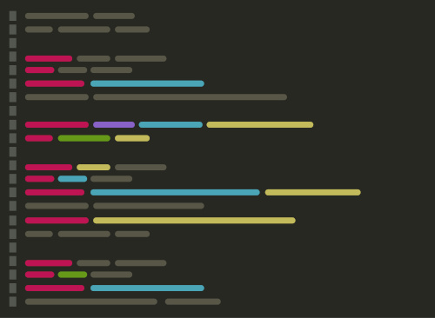
GEOG 4/590: Geospatial Data Science
Lecture 1: Introduction

Slide 2
Welcome
Dr. Johnny Ryan, Assistant Professor of Geography
BSc in Geography at University of Nottingham, UK
MPhil in Polar Studies at University of Cambridge, UK
PhD in Geography at Aberystwyth University, UK
Postdoc at the institute at Brown for Environment and Society, RI, USA
Researching glaciology, hydrology, remote sensing
Email: jryan4@uoregon.edu
Office: 163A Condon Hall
Office hours: Monday 15:00-16:00 and Friday 09:00-10:00

Slide 3
Get to know your neighbours!
Please introduce yourself with your:
name
year
where you’re from
favourite place to eat in Eugene

Slide 4
Overview
What is Geospatial Data Science?
Spatial data (e.g. geometries and projections)
Coding (e.g. Python)
Collaborating (e.g. GitHub)
Course schedule
Lectures, labs, grading
Final project
Some tasks
Complete background survey on Canvas
Getting started in Fridays lab session

Slide 5
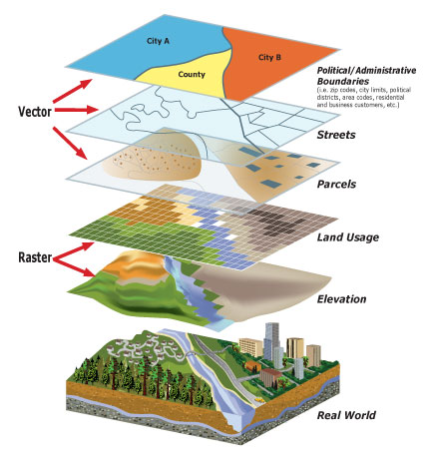
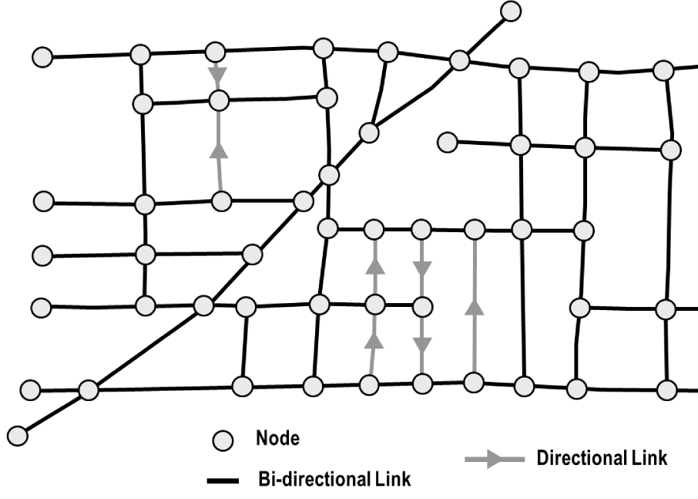
Geospatial data
Vector data
Network data
Raster data
Notes:
Geometries, projections, grid cell size, network data has nodes and paths

Slide 6
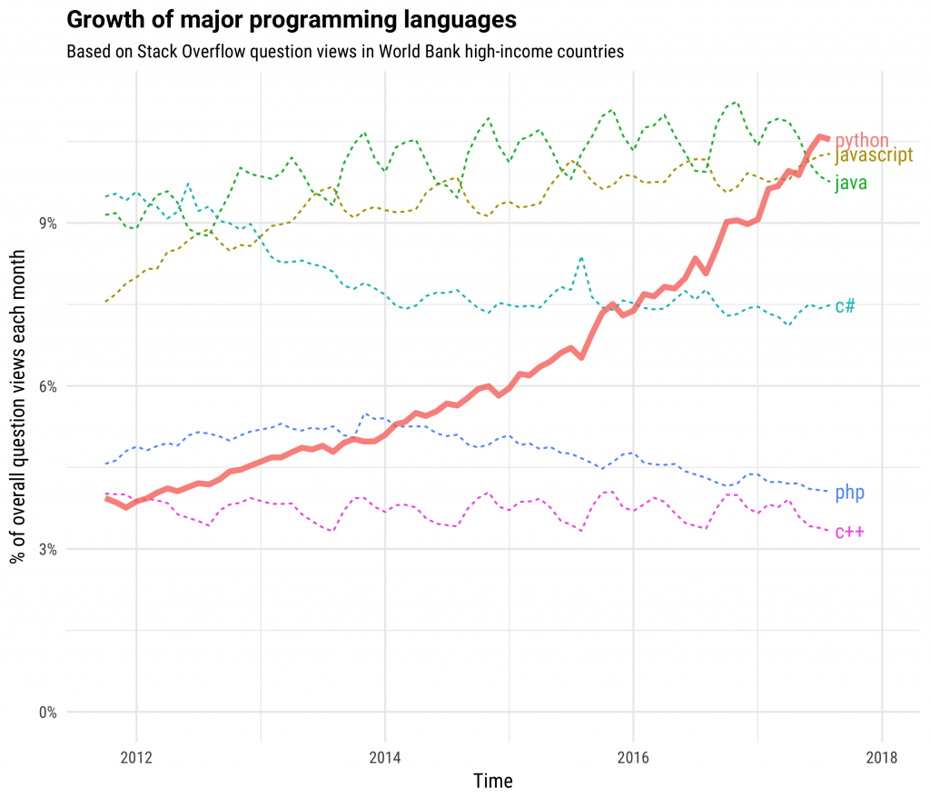

Python
Popular high-level programming language
Easy-to-read
Extensive and mature libraries
Free and open-source
Accessible
Can be examined, modified, and improved
Constantly evolving
Notes:
We need flexible tools to process, analyze, and visualize data. This may seem like a superficial point, but it is crucial for effective sharing of code. Even if you are the only one reading your code, python is easy on the eyes. Provides the tools to do almost anything you can imagine. If we want to have transparent, reproducible, scientific results, we should be using open source tools. Unlike MATLAB or ArcGIS. The world is changing: data is exploding, computers architecture is evolving, and new forms of analysis and visualization are being invented. Python is evolving too, and it evolves based on what the community needs.

Slide 7


Git and GitHub
Git
Version control software for tracking changes to a set of files
GitHub
A cloud-based Git repository hosting service
Makes it easier to coordinate work among programmers collaboratively developing source code during software development
Python and projects that use Python (e.g. matplotlib) are all maintained and developed by a community of scientists and programmers on GitHub
An active, up-to-date GitHub profile, with contributions to open-source project is a great way to provide evidence of skills
Notes:
Some of whose work is supported by universities, non-profits, and for-profit corporations.

Slide 8
Course schedule
Lectures: Monday 2pm in 471 MCK
Eight lectures
Holiday on Jan 16
Labs: Fridays @ 10am or noon in 442 MCK
Seven labs
Two labs to concentrate on final project
Class presentations in Week 10
Notes:
We have a lot to cover

Slide 9
Course evaluation
Lab assignments (45%) due every Friday 11:59 pm
Final project (45%)
Presentations due March 13, 11:59 pm
Write-ups due March 17, 11:59pm
Participation (10%)
Credit can be earned through attendance in lectures, participation in class discussion (both virtual and in-person), visiting Professor and GE during office hours, and helping other students in labs.
Notes:
We have a lot to cover

Slide 10
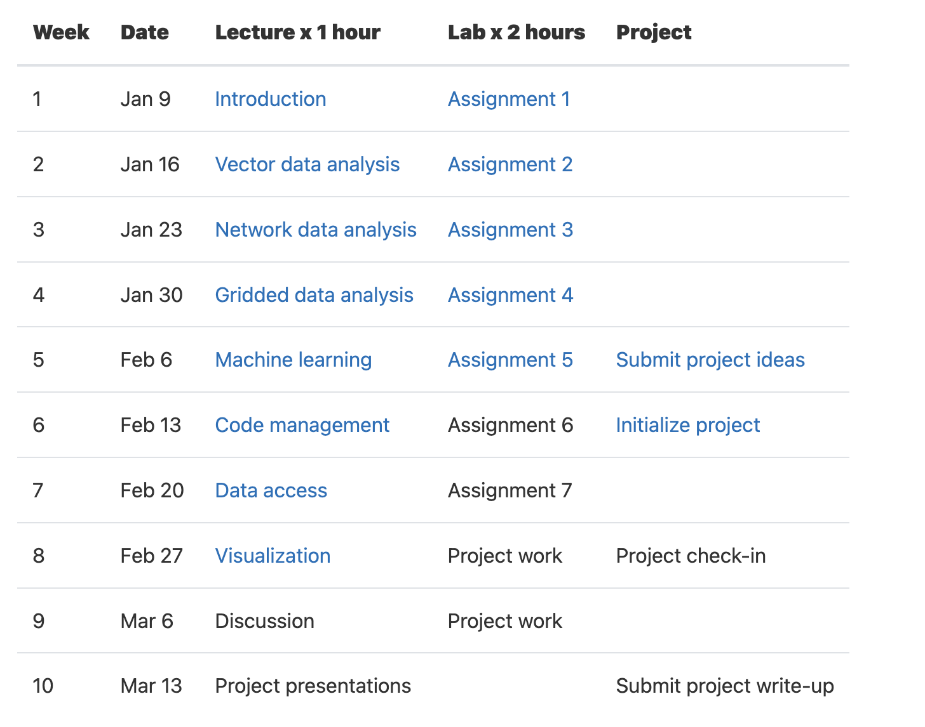
Working with geospatial data
Notes:
We have a lot to cover

Slide 11
Working with geospatial data
Machine learning
Notes:
We have a lot to cover

Slide 12
Working with geospatial data
Machine learning
Key skills
Notes:
We have a lot to cover

Slide 13
Final project
An opportunity to explore a particular topic of interest using some of the skills developed in this course
Students can work independently or in groups of two or three
Sharing of project ideas on Slack is encouraged so we can form teams

Slide 14
Final project schedule
Week 5: Discuss project ideas with peers and instructors, submit a short summary of a project idea on the #final-projects Slack channel
Week 6: Form teams, create GitHub repo, and provide some basic info about project as a README.md
Week 8: Provide informal update to instructors, ensure data has been accessed, goals are accomplishable
Week 10: Present project to class and submit write-up by the end of the week

Slide 15
Final project schedule
Week 5: Discuss project ideas with peers and instructors, submit a short summary of a project idea on the #final-projects Slack channel
Week 6: Form teams, create GitHub repo, and provide some basic info about project as a README.md
Week 8: Provide informal update to instructors, ensure data has been accessed, goals are accomplishable
Week 10: Present project to class and submit write-up by the end of the week

Slide 16
Final project schedule
Week 5: Discuss project ideas with peers and instructors, submit a short summary of a project idea on the #final-projects Slack channel
Week 6: Form teams, create GitHub repo, and provide some basic info about project as a README.md
Week 8: Provide informal update to instructors, ensure data has been accessed, goals are accomplishable
Week 10: Present project to class and submit write-up by the end of the week

Slide 17
Final project schedule
Week 5: Discuss project ideas with peers and instructors, submit a short summary of a project idea on the #final-projects Slack channel
Week 6: Form teams, create GitHub repo, and provide some basic info about project as a README.md
Week 8: Provide informal update to instructors, ensure data has been accessed, goals are accomplishable
Week 10: Present project to class and submit write-up by the end of the week

Slide 18
Final project schedule
Week 5: Discuss project ideas with peers and instructors, submit a short summary of a project idea on the #final-projects Slack channel
Week 6: Form teams, create GitHub repo, and provide some basic info about project as a README.md
Week 8: Provide informal update to instructors, ensure data has been accessed, goals are accomplishable
Week 10: Present project to class and submit write-up by the end of the week
I will send reminders out about upcoming milestones

Slide 19
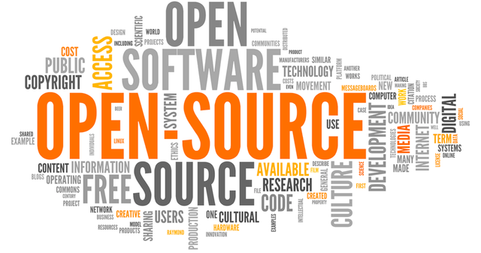
Some course themes
Everything is open-source
All software we use is freely available
Labs can be completed anytime, anywhere from any OS
Course materials are publicly-available on the internet

Slide 20
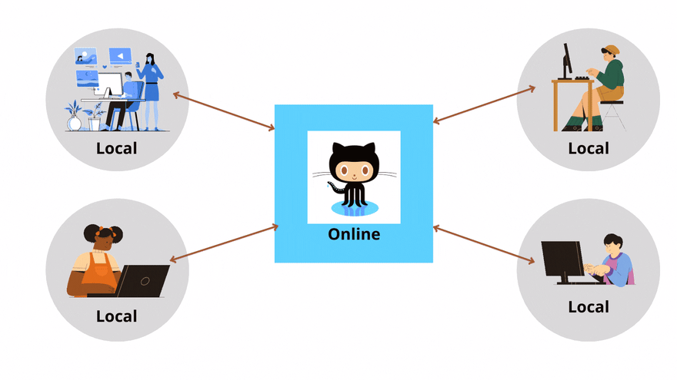
Some course themes
Promote collaboration and communication
With instructors and peers
On GitHub and Slack

Slide 21
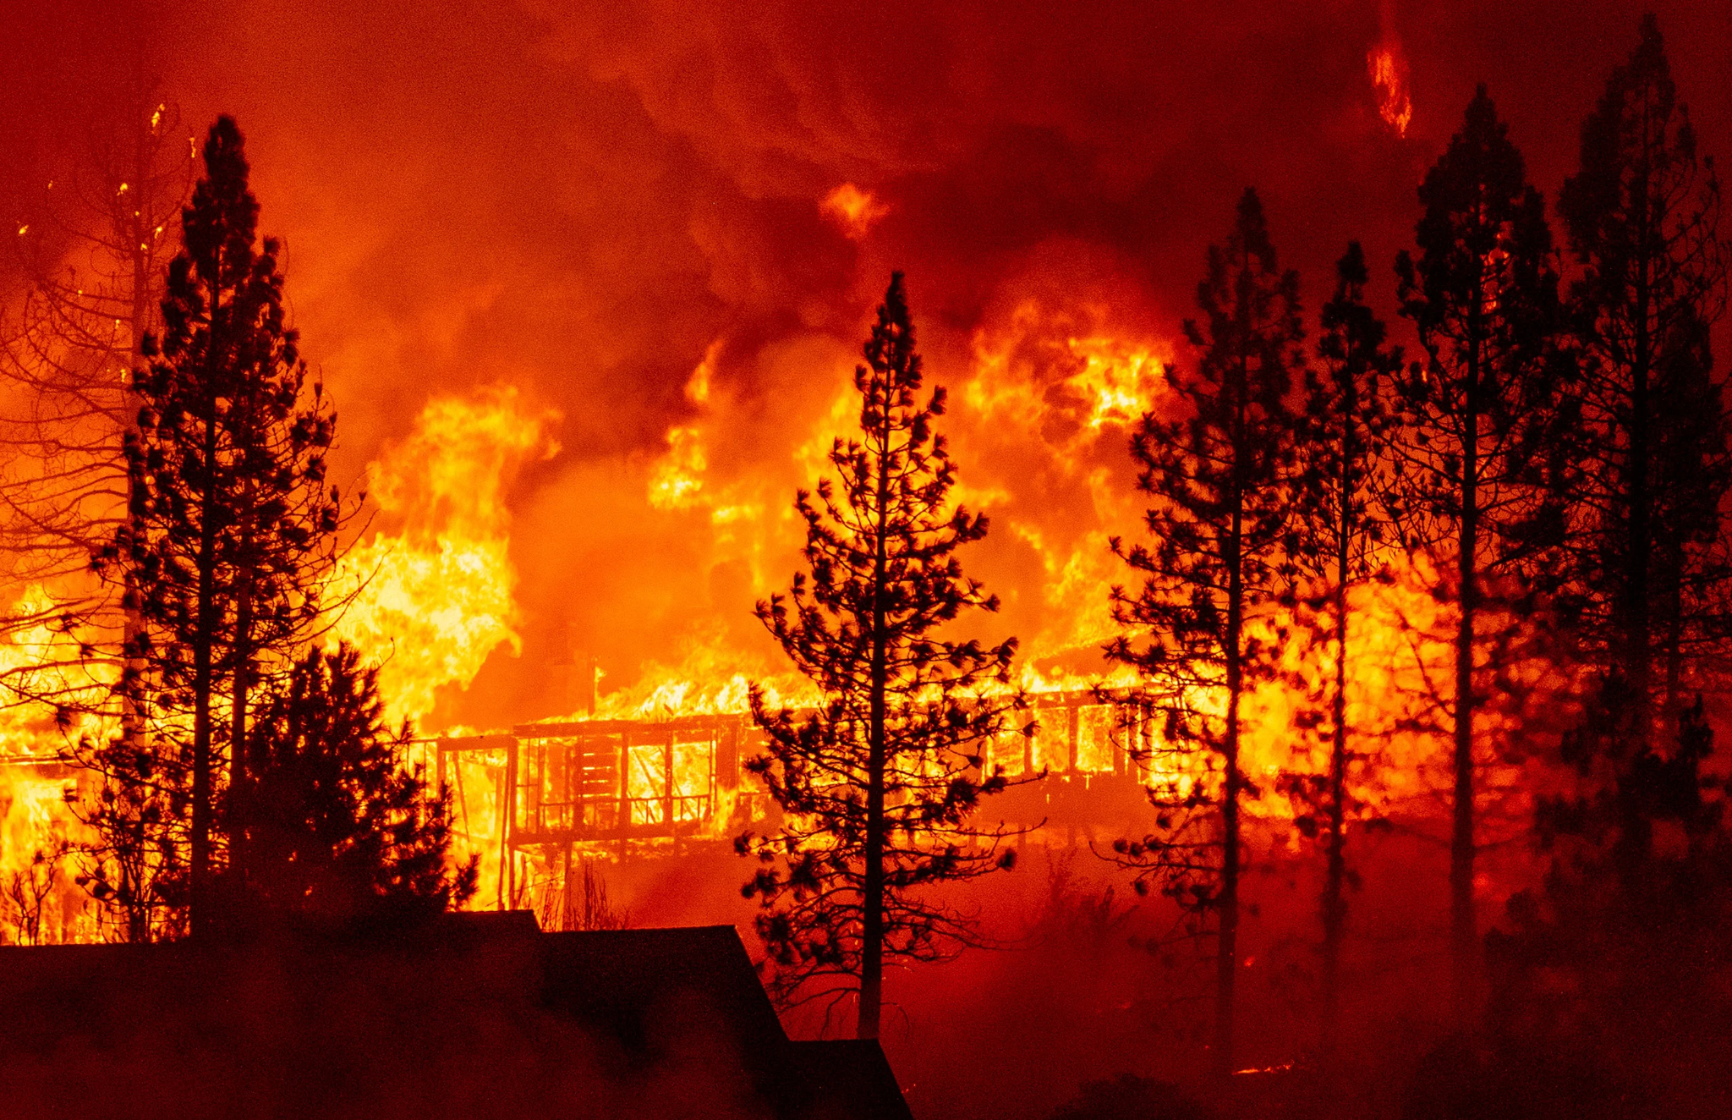
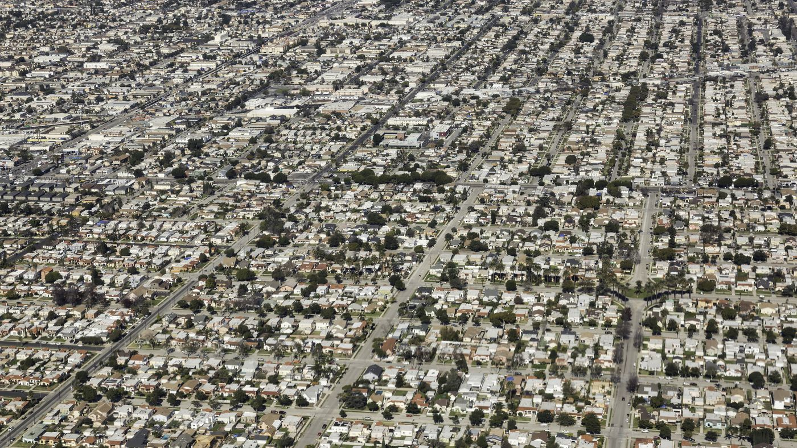
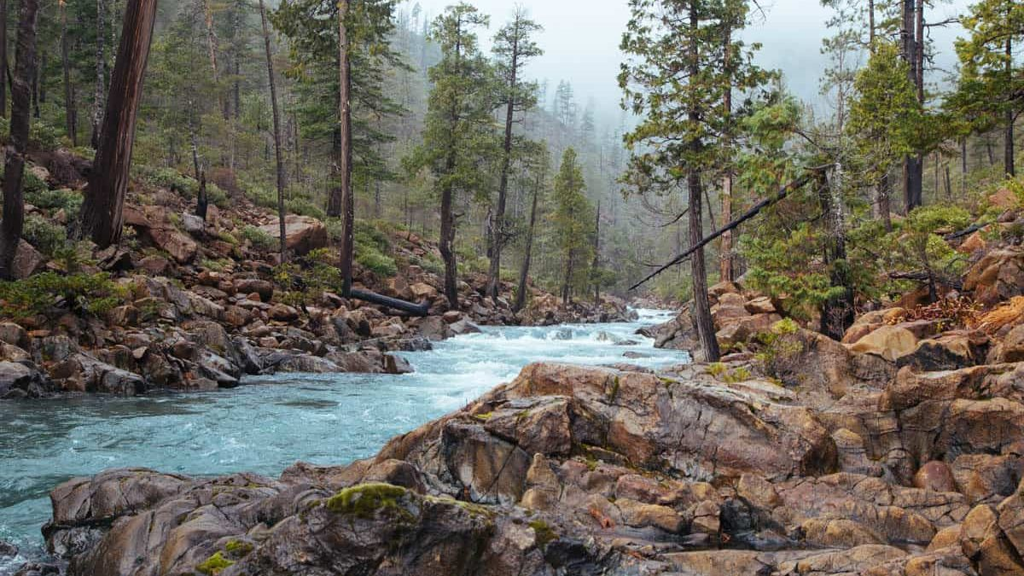
Some course themes
Learn about environmental challenges in the Western US
Urban planning and zoning
Hazards (e.g. wildfires, flooding)
Energy, climate, hydrology

Slide 22
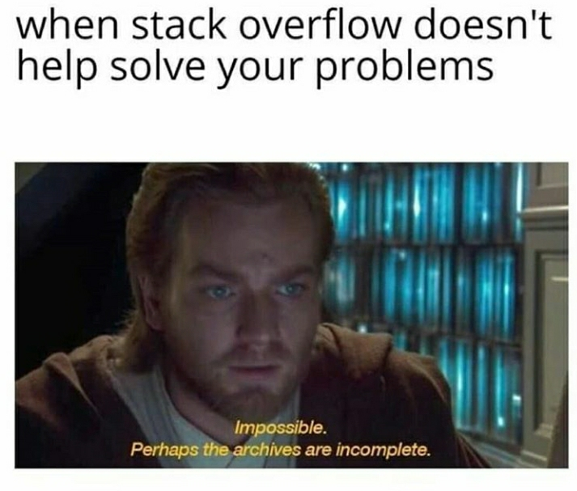
Some course themes
Don’t try and write perfect code, if it works, it works
It's not always necessary to write code, adapting code is quite normal
Make use of stackoverflow
Don't be afraid to ask (peers or instructors)
Notes:
If you’re having a problem, someone has probably also had that problem. Data science is as much about learning how to write the right question in Google rather than remember the right syntax. I haven’t taken a Computer Science course in my life. There are some very good programmers in this class, ask them for help.

Slide 23
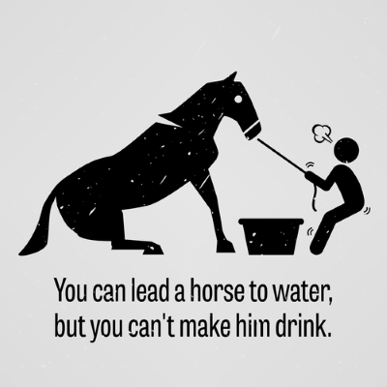
Some course themes
Take responsibility for learning
Organize your files
Check Canvas and Slack regularly
Maintain your GitHub profile and repository
Notes:
I am your tour guide to the world of Geospatial Data Science. I can point out things like this is the best way to reproject data using Python. I can answer your questions. But I can’t make you a great programmer. You have to be responsible for you learning.

Slide 24

Some course themes
Notes:
None of this “Hello world” intro to programming stuff. After this week, we will be doing useful things with our code.

Slide 25
By the end of this course you will…
Have confidence using Python specifically for GIS and other geospatial data science applications
In doing so, you will also be comfortable using Python for other things as well
Be able to download, process, analyze, and visualize the main types of geospatial data
Automate boring GIS tasks (no more clicking!)

Slide 26
By the end of this course you will…
Improve programming skills
Learn how think computationally and statistically
Solve real-world problems using spatial analysis
Run basic machine learning models
Manage a data science project using version control
Collaboratively develop a data science project
Communicate results of data science project orally and as a short write-up

Slide 27
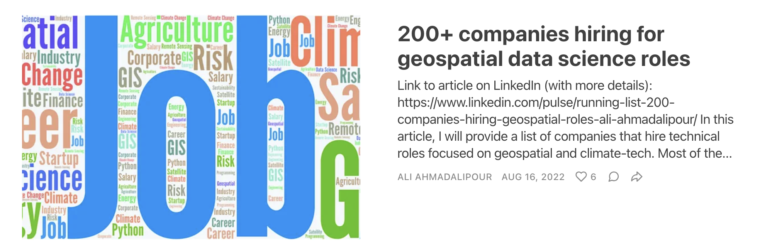
Careers

Slide 28



Getting started on this week’s lab
Go to course page:
https://owel-lab.github.io/gds-applications-site/intro.html
Also see Canvas for links

